Slide 1
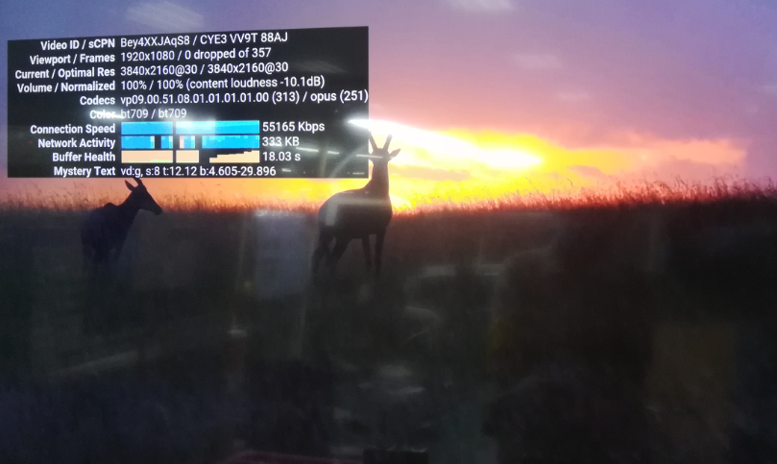
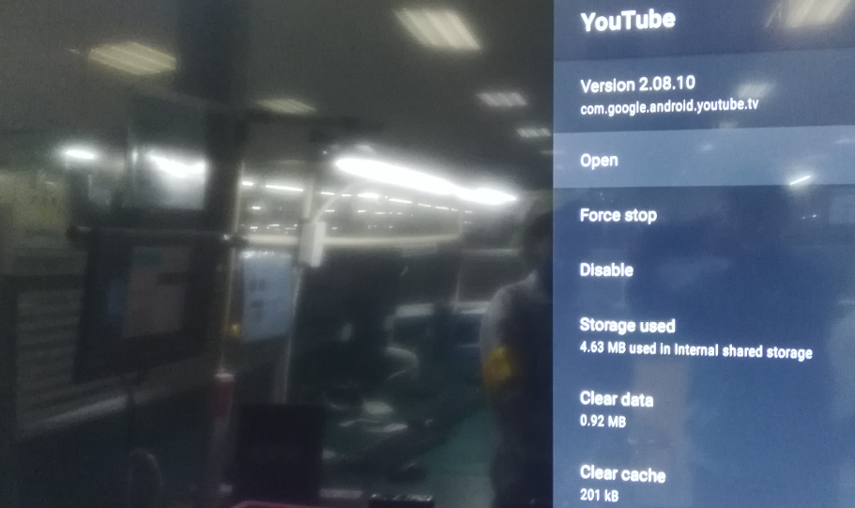
OTT System unstable
Issue Description | FA and Root Cause | Actions | Owner | Due Date | Status
Phenomenon: System unstable Type: Critical Q’ty : 1/500pcs DR: 0.2% | 1. OBA recheck and found out the failure system as original failure of customer highlight ( Run the youtube and play 4K video --> few minute later, system will be auto back out 4K video screen as below picture. 2. Restore default system and test again then OTT auto rebooting during play 4k video. 3. Open housing --> X_RAY inspection and Visual inspection no issue found. 4. Checked power rail: P5V, P3V3, P1V8, P1V8_EMMC, P1V2, P2V5, VDDCPU, VDDEE and systems clock no issue found. 5. Use the USB_Burning_Tool to upgrade again --> back to factory mode and retest all test stations then pass. 6. OBA check again then pass --> no problem was found 7. OBA did ORT check (played 4K video for 3 days) 8. Checked the log and found the issue from MW. | From the log analysis(screen capture as below), the root cause was that MW suspended youtbue and need ALT to check with TVStorm. | TVStorm | Done

